Slide 1
CS4432: Database Systems II
More on Index Structures

Slide 2
More On B-Tree Deletion

Slide 3

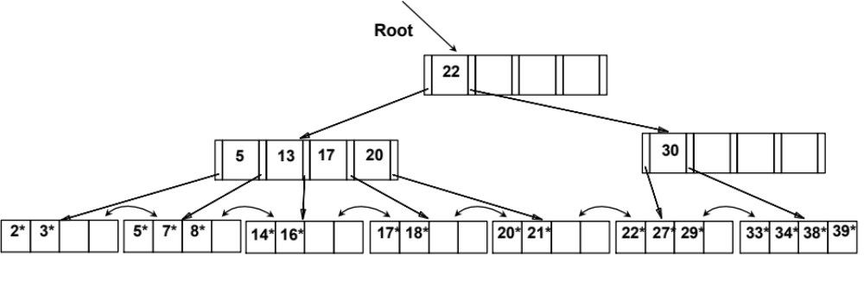
Example of Non-leaf Re-distribution
Assume in the middle of deleting a key we are have the tree below.
Node with key 30 has an entry just deleted and now it is below the minimum threshold
How to continue?
Notes:
17

Slide 4

How to Re-distribute Non-leafs
Take the keys of the two nodes + the parent key [5, 13, 17, 20, 22, 30]
The middle key will go up, and the rest divided into two. Then fix the pointers
In our case (even number of keys), two correct alternatives:
  [5, 13] [17] [20, 22, 30]
  [5, 13, 17] [20] [22, 30]
Notes:
17

Slide 5
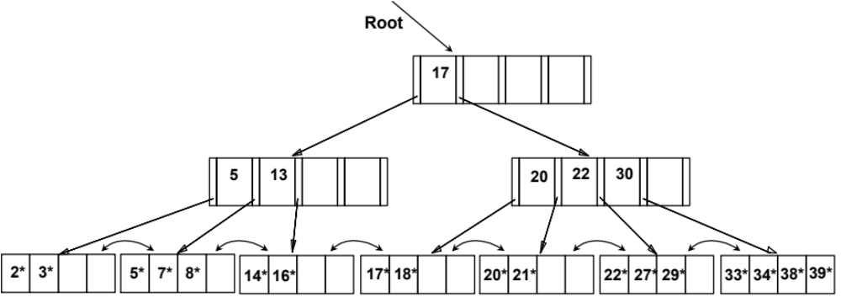
After Re-distribution (1st Alternative)
Intuitively, entries are re-distributed by `pushing through’ the splitting entry in the parent node.
Notes:
18

Slide 6
Exercise
Create the tree if you follow the 2nd alternative…
Notes:
18

Slide 7
More On B-Tree Insertion
Duplicate Keys

Slide 8
Example Inserting Duplicate Keys
Insert 20
Root
17
5
13
24
30
2*
3*
5*
7*
8*
14*
16*
19*
20*
22*
24*
27*
29*
33*
34*
38*
39*
Notes:
13

Slide 9
Example Inserting Duplicate Keys
Insert 20
Root
17
5
13
24
30
2*
3*
5*
7*
8*
14*
16*
19*
20*
20*
22*
24*
27*
29*
33*
34*
38*
39*
Notes:
13

Slide 10
Example Inserting Duplicate Keys
Insert 20 again
Root
17
5
13
24
30
2*
3*
5*
7*
8*
14*
16*
19*
20*
20*
22*
24*
27*
29*
33*
34*
38*
39*
Need to split the node [19, 20, 20, 20, 22]
Lets go for [19, 20] & [20, 20, 22]
Copy up
Notes:
13

Slide 11
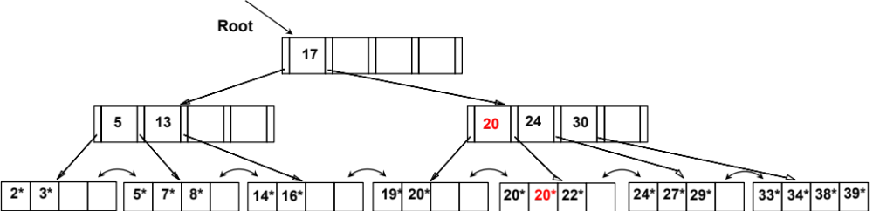
Something is Wrong !!!
Search for key = 20 ➔ Leads to wrong answer
When duplicate keys span multiple nodes
Copy up the smallest new key
Notes:
13

Slide 12
Now Things are Correct
22
22*
Search for key = 20 ?
Remember, we move right until all keys = 20 are consumed
Notes:
13

Slide 13
Insert 20 & 20 Again
22
20*
20*
20*
22*
Notes:
13

Slide 14
Insert One More 20
22
20*
20*
20*
22*
Need to split the node [19, 20, 20, 20, 20]
Lets go for [19, 20] & [20, 20, 20]
There is no new key. Which value to copy up
Copy up a Null Key (Special value)
Notes:
13

Slide 15
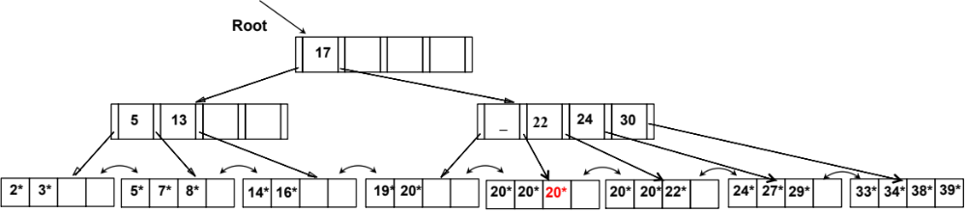
Null Key Propagated Up
When searching for any key 17 <= k < 22
  Follow the pointer before the Null entry
Notes:
13

Slide 16
Multi-Key Indexing

Slide 17
Multi-Key Indexing
Multi-key indexing is NOT Multi-level indexing
  They are different
Assume this query is common
  select account_number
  from account
  where branch_name = “Perryridge”
  and balance = 1000
How to evaluate this query?
Two predicates on two columns: branch_name & balance

Slide 18
Strategy I
Assume this query is common
Strategy I: Table Scan
Scan table accounts, one record at a time
Check the conditions
  select account_number
  from account
  where branch_name = “Perryridge”
  and balance = 1000
Two predicates on two columns: branch_name & balance

Slide 19
Strategy II: Assume Balance has B-Tree Index
Strategy II: Index Probe on Balance
Use a B-tree index on column Balance (key = 1000)
For all returned pointers from the index, retrieve the records
Check the branch_name condition
Assume this query is common
  select account_number
  from account
  where branch_name = “Perryridge”
  and balance = 1000
Two predicates on two columns: branch_name & balance

Slide 20
Strategy III: Assume Branch_Name has B-Tree Index
Strategy III: Index Probe on Branch_Name
Use a B-tree index on column Branch_name (key = ‘Perryridge’)
For all returned pointers from the index, retrieve the records
Check the balance condition
Assume this query is common
  select account_number
  from account
  where branch_name = “Perryridge”
  and balance = 1000
Two predicates on two columns: branch_name & balance

Slide 21
Strategy IV: Intersect Two Indexes
Strategy IV: Use Both Indexes
Use a B-tree index on column Branch_name (key = ‘Perryridge’)
Return a set of pointers ➔ S1
Use a B-tree index on column Balance (key = 1000)
Return a set of pointers ➔ S2
Intersect S1 and S2 ➔ S3
Retrieve the records of S3 pointers
Assume this query is common
  select account_number
  from account
  where branch_name = “Perryridge”
  and balance = 1000
Two predicates on two columns: branch_name & balance

Slide 22
Another Strategy: Multi-Key Index
  select account_number
  from account
  where branch_name = “Perryridge”
  and balance = 1000
Since this query type is common
  Create a multi-key index on branch_name & Balance
All records with “branch_name” = x
Are indexed here based on “balance”
Leaf nodes contain unique values for “Branch_name”
B-Tree
(balance)
x
B-Tree
(Branch_name)
y
I3

Slide 23
Example
  select account_number
  from account
  where branch_name = “Perryridge”
  and balance = 1000
Query answer
Indexes on
Balance
Strategy: Multi-Key Index
Use the B-tree index on column Branch_name (key = ‘Perryridge’)
Follow the pointer to the B-Tree index on “Balance”
Search for key = 1000
1k
15k
Perryridge
17k
B1
21k
B2
Index on
Branch_name
12k
15k
15k
19k
21k

Slide 24
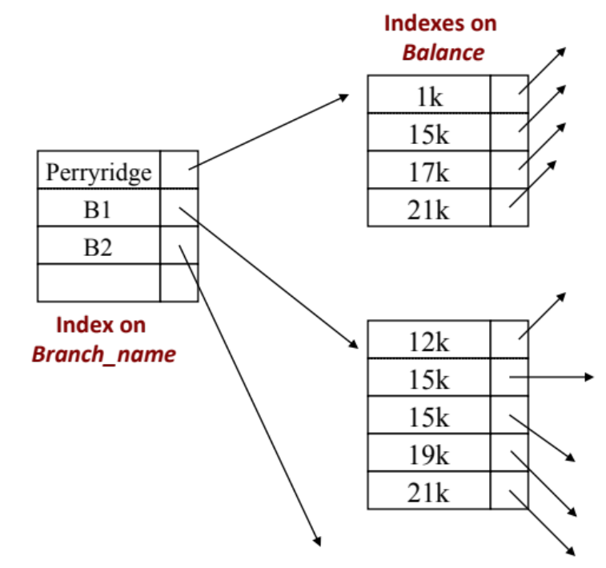

Multi-Key Indexes: Order Matters
For which queries we can use this index?
  …
  where branch_name = “Perryridge”
  and balance = 1000;
  …
  where branch_name > “B1”
  and branch_name < “B5”
  and balance = 500;
  …
  where branch_name > “B1”
  and branch_name < “B5”;
As long as there is a condition on Branch_name (the 1st level) ➔ The index can be used

Slide 25

Multi-Key Indexes: Order Matters
For which queries we can use this index?
  …
  Where balance = 1000;
  …
  Where balance < 500;
  …
  where branch_name <> “B1”
No condition on branch_name
Non-equality conditions are bad ..

Slide 26
Summary So Far
Primary vs. Secondary Indexes
Dense vs. Sparse Indexes
Single-Level vs. Multi-Level Indexes
B-Tree Index
B-Tree Index on Multi-Key

